Slide 1
Prediction of song mood through Lyrics
Krishi Agrahari Rajsi Kesharwani Kirti Mohitkar Shazia Khan Nikhil Kamale
Project Incharge – Priyanka Padmane
Priyadarshini College of Engineering, Nagpur
Computer Technology
Group No 17
April 29, 2022
Mood Prediction
April 29, 2022
1 / 21

Slide 2
Project Overview
Main Goal of the Project
Develop a Mood Classification System from song lyrics as well by combining a wide range of semantic and stylistic features extracted from textual lyrics.
Problem definition
The primary focus of the project is to develop a model that analyses a song by its lyrics and to detect the mood in the song. A few of such work have been done on English songs, but we are to explore it by also putting Hindi songs to it. The methodology used by far is the translation of songs in other languages to English and then analyse, because a lot of annotated datasets are available in English.
Mood Prediction
April 29, 2022
2 / 21

Slide 3

Project Overview
Results of the project
The project aims at developing a system to predict songs’ mood and clustering them which can be used in a Recommendation System based on users’ listening habit and their choice of genres. The project is also based on predicting mood of Bollywood songs by translating their lyrics to Hindi and using approaches of NLP, Polarity based Classification by combining a wide range of semantic and stylistic features extracted from the lyrics.
Mood Prediction
April 29, 2022
3 / 21

Slide 4
Project Milestones and Timelines
Studying project related research papers and literature.
Understanding and interpreting the implementations already out there.
Exploring places from where dataset to be created.
Data preprocessing and feature selection.
Model exploration and selection.
Model Implementation
Measuring performance of the model.
Improving the model by changing certain parameters.
Reporting the results and inferences.
Project Report, Presentation Preparation.
Mood Prediction
April 29, 2022
4 / 21

Slide 5

Main Challenges
Training Dataset Preparation (Using English Song Lyrics)
Test Dataset Preparation (Using Hindi Song Lyrics translated to english)
Data Preprocessing Feature Engineering
Machine Learning Model Preparation
Model Selection and Prediction
Mood Prediction
April 29, 2022
5 / 21

Slide 6
Training Dataset Preparation
The dataset that we start with is a 10000 Song subset of the Million Song Dataset. Now we do the following :
Store the dataset into a Pandas Dataframe with features File Name, Artist Name, Song Name
Using the Artist Name and Song Title, We are fetching lyrics for all the songs using
PyLyrics package, which uses LyricWikia.com API to get lyrics for songs
We are creating our model using english lyrics. So all the song lyrics containing any other language are removed from the Dataset.
Now we will use Last.FM API to extract Tags for the remaining 3000 songs in our dataset. Tags can be based on Genre, Mood, Artist Type etc.
Mood Prediction

Slide 7
Training Dataset Preparation
In the paper Lyric Text Mining in Music Mood Classification, Hu et.al, Last.FM tags are being grouped into 18 categories according to different human moods. We have taken 10 groups from it and distributed them into our Mood Categories - Happy, Sad, Angry, Relax.
Happy Tags : cheerful, cheer up, festive, jolly, gleeful etc. Sad Tags : sadness, unhappy, melancholic, depress etc.
Angry Tags : anger, angry, choleric, fury, outraged, rage etc. Relaxed Tags : calm, comfort, quiet, serene, mellow etc.
By correlating the Tags that we found from Last.FM and the tag groups generated by us, we are creating the Class Labels for Moods in our Dataset.
From the paper Multimodal Music Mood Classification by Fusion of Audio and Lyrics, Hao et.al , we get to know about 777 other songs, already categorized into Happy, Sad, Angry, Relaxed. We append this dataset with our previous dataset for our final training dataset.
Mood Prediction

Slide 8
Test Dataset Preparation
We manually collected over 250 Hindi song lyrics and stored into dataframe
Using Google Translate API, we auto-translated them into English lyrics and manually labelled them for performance checking.
As our test dataset is labelled manually and training dataset is auto-labelled from the tags of Last.FM and Hao’s paper, we add a fraction of translated-to-english lyrics to our training dataset to reduce the bias of the testing dataset.
Mood Prediction

Slide 9

Data Preprocessing
We have lyrics in our data. To Preprocess the lyrics column we do following preprocessing steps
Tokenization : Taking a text or set of text and breaking it up into its individual words
Stop-word Removal : Stop words such as the, a, an, in are removed from lyrics
Punctuation Removal : Removes punctuation from lyrics
Stemming : Reducing inflected (or sometimes derived) words to their word stem, base or root form
Lemmatization : Process of grouping together the inflected forms of a word so they can be analyzed as a single item, identified by the word’s lemma, or dictionary form
Mood Prediction

Slide 10
Feature Engineering
Wordlevel TfIdf
tfidf, short for term frequency inverse document frequency, is a numerical statistic that is intended to reflect how important a word is to a document in a collection or corpus. The tfidf value increases proportionally to the number of times a word appears in the document and is offset by the number of documents in the corpus that contain the word
n gram model
An n-gram is a contiguous sequence of n items from a given sample of text or speech. An
n-gram model is a type of probabilistic language model for predicting the next item in such a sequence in the form of a (n - 1) order Markov model. Two benefits of n-gram models are simplicity and scalability : with larger n, a model can store more context with a well-understood space-time tradeoff, enabling small experiments to scale up efficiently.
Mood Prediction

Slide 11
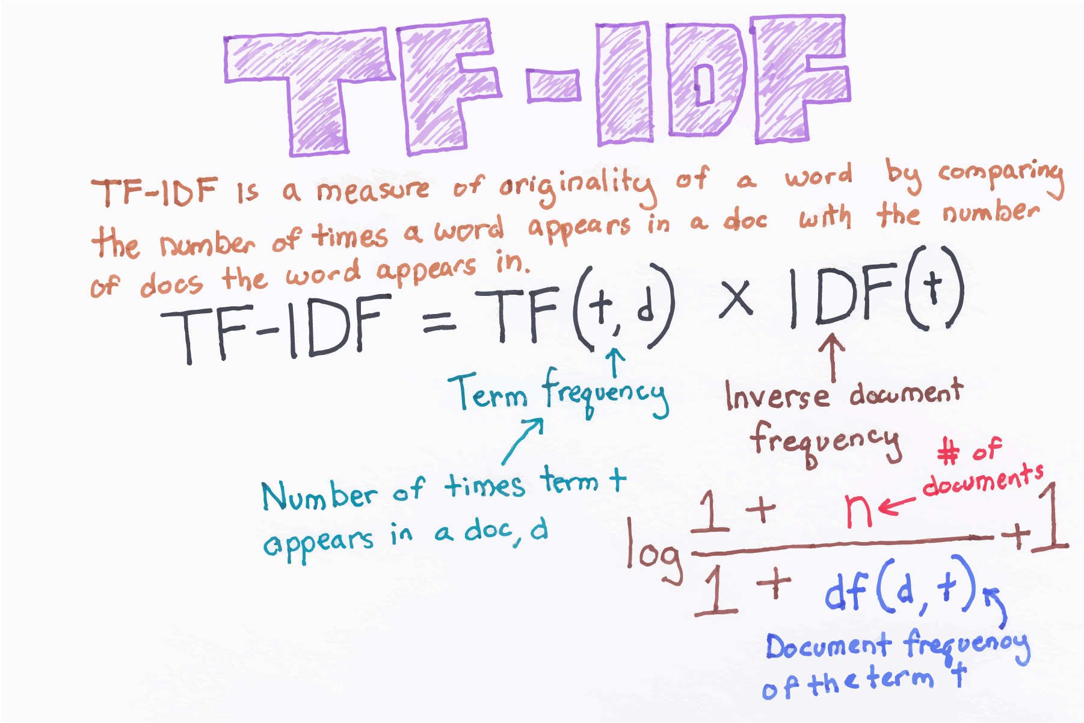
Feature Engineering
Mood Prediction

Slide 12
Learning Models
We have created Training, Validation datasets for each of these 3 NLP Models
CountVectorizer WordLevel tfidf NGram Vectors
Word2vec Embedding vectors
The following classifiers are used for model preparation and testing : Random Forest
Multinomial Naive Bayes Logistic Regression Ensemble - Bagging Ensemble - Boosting Support Vector Machines Convolutional Neural Net
Mood Prediction

Slide 13
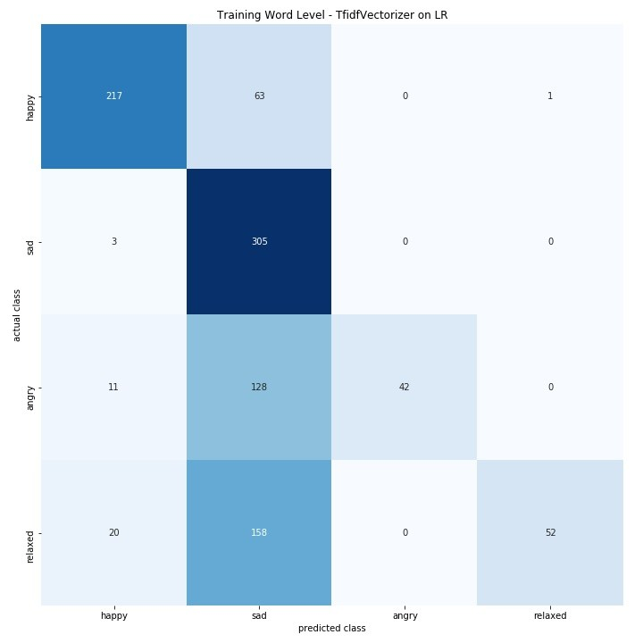
Validation Dataset Results
The validation dataset, which was created from a fraction of the training dataset of english song lyrics, saw an accuracy of atmost 53% for the TFIDF model using Logistic Regression Model as the machine learning model.
Here is the confusion matrix
-
Mood Prediction

Slide 14
classifier Results
Here are the accuracy scores on our test datasets for each 3 NLP models
Classifier | CountVect | TfidfVect | NGramVect
Naive Bayes | 47.2 | 40.5 | 54.1
Random Forest | 57.2 | 58.7 | 52.5
Logistic Regression | 55.8 | 56.2 | 46.3
Boosting | 46 | 42.5 | 33.1
Bagging | 55.3 | 53.5 | 51.7
SVM | 55.7 | 60 | 55
Table: Different agents and corresponding networks
Mood Prediction

Slide 15
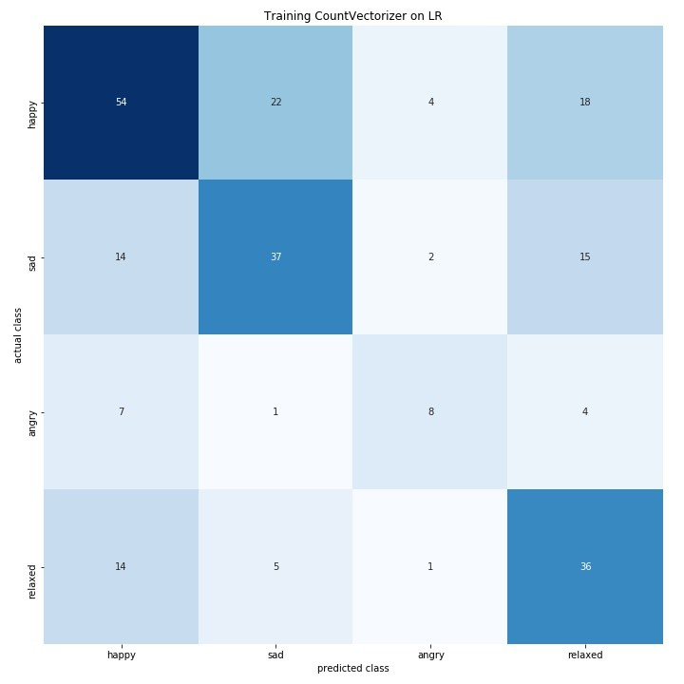
Logistic Reg on CountVectorizer
Mood Prediction

Slide 16
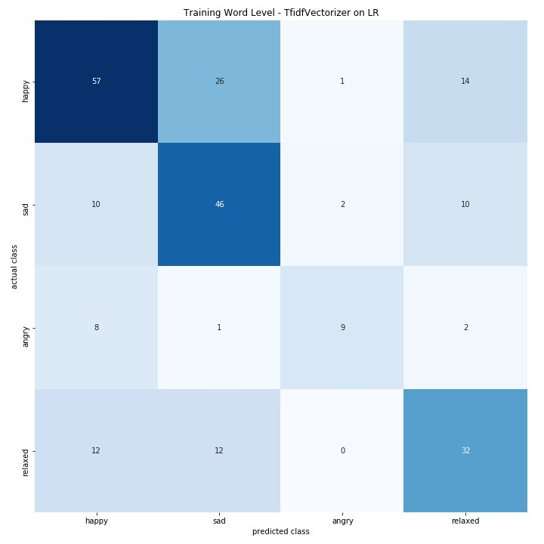
Random Forest on TfidfVectorizer
Mood Prediction

Slide 17
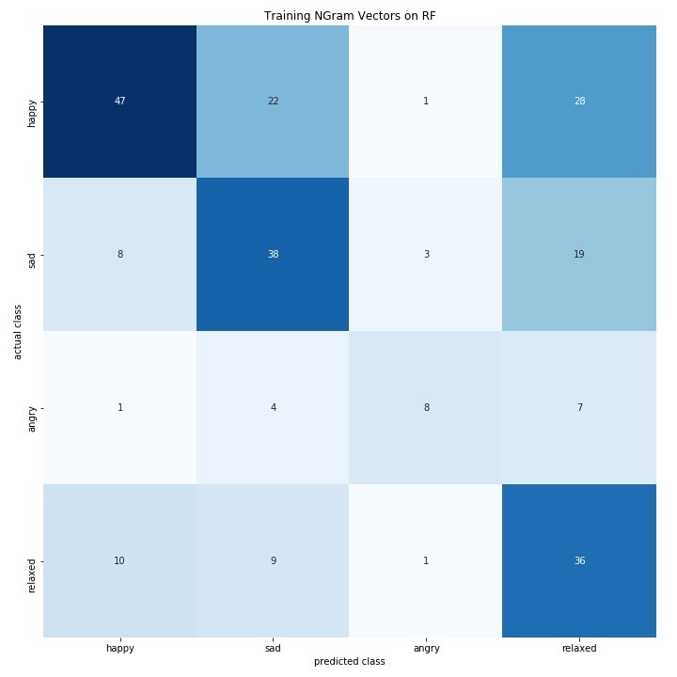
Random Forest-Bagging on NGram Vectorizer
Mood Prediction

Slide 18
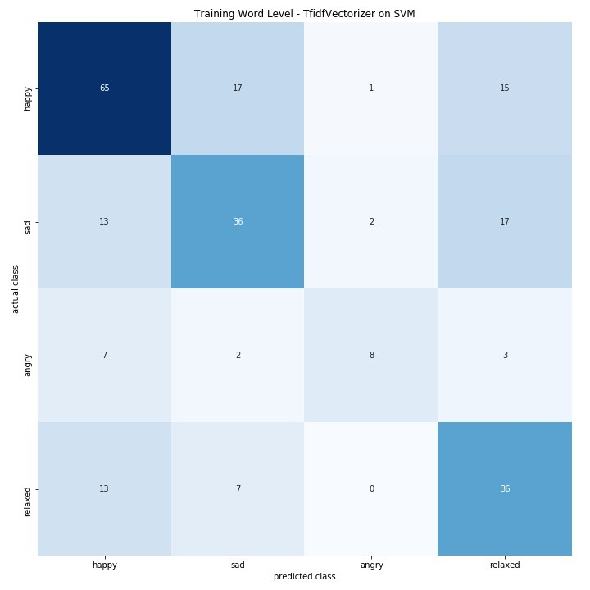
Best Model for us
Figure: SVM with TFIDF Vectorizer
Mood Prediction

Slide 19
Classification Report
During Validation with English lyrics validation dataset,along with a highest accuracy of 56%, we got the following -
Precision : 0.63
Recall : 0.56
F1-Score : 0.58
During testing with Bollywood Hindi Songs translated-to-English lyrics dataset, using SVM, we got an accuracy of 60% and the following -
Precision : 0.63
Recall : 0.62
F1-Score : 0.63
Mood Prediction

Slide 20
Future works
We trained our model using Word2Vec along with CNN with pre-trained genism library.However, we obtained approx. 40% accuracy due to which we decided not to go along with it due to small size of training data and might need to change the parameters to obtain better results.
Also, we can further add a Web based Search and Recommender Engine where a user can obtain his songs according to his choice of mood using our model.
Using Selenium and BeautifulSoup4 library we can automate the action of retrieving and parsing the data and then passing it through Google translator API to the get the English lyrics for generating our test dataset.
Mood Prediction

Slide 21
Bibliography
Xue, H., Xue, L., Su, F. Multimodal Music Mood Classification by Fusion of Audio and Lyrics. MMM 2015, Part II, LNCS 8936, pp. 26â37, 2015.
X. Hu, J. S. Downie, A.Ehmann. Lyric Text Mining in Music Mood Classification. ISMIR 2009, Oct. 2009.
Sebastian Raschka. MusicMood: Predicting the mood of music from song lyrics using machine learning. arXiv:1611.00138v1 [cs.LG] 1 Nov 2016
Cecilia Ovesdotter Alm. Emotions from text: machine learning for text-based emotion prediction. (HLT/EMNLP), pages 579â586, Vancouver, October 2005.
Patra, Das, BandyoPadhyay. Automatic Music Mood Classification of Hindi Songs. IJCNLP 2013, pages 24â28, Nagoya, Japan, October 14, 2013.
Mood Prediction

